Slide 1
Assumptions In Multiple Regression Analysis (MRA)
Regression Analysis and Non-Linear Models: Sociology 6100

Slide 2
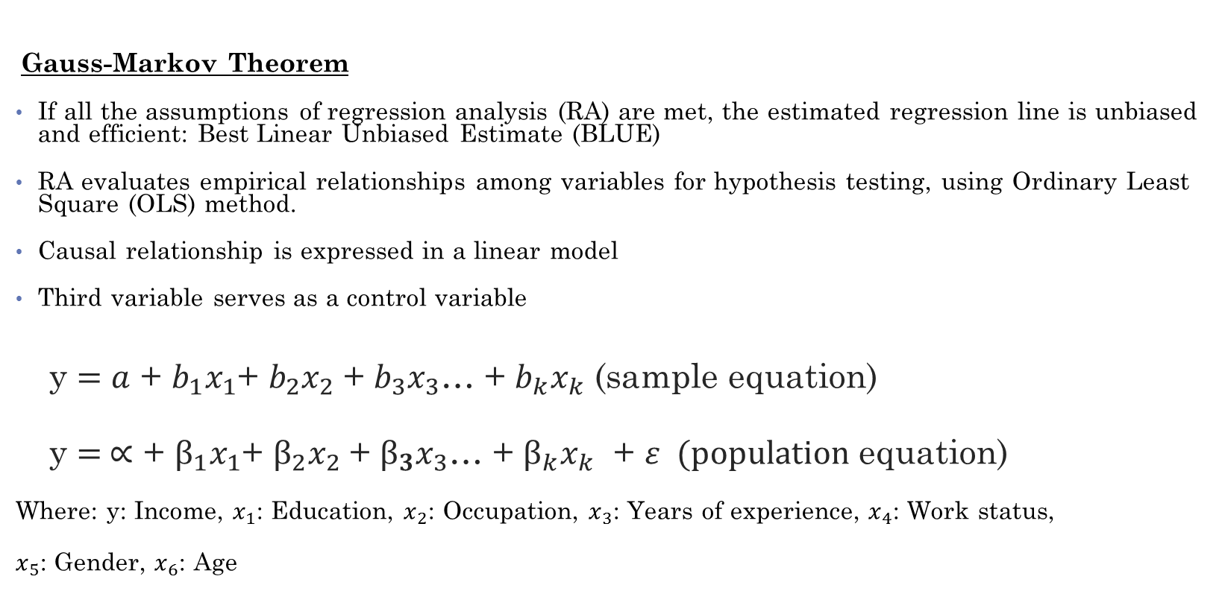
1. Theoretical Model Building
Gauss-Markov Theorem
If all the assumptions of regression analysis (RA) are met, the estimated regression line is unbiased and efficient: Best Linear Unbiased Estimate (BLUE)
RA evaluates empirical relationships among variables for hypothesis testing, using Ordinary Least Square (OLS) method.
Causal relationship is expressed in a linear model
Third variable serves as a control variable
y $=a$ + $b_{1}x_{1}\text{+ }b_{2}x_{2}$ + $b_{3}x_{3}$… + $b_{k}x_{k}$ (sample equation)
y $= ∝$ + $β_{1}x_{1}\text{+ }β_{2}x_{2}$ + $β_{3}x_{3}$… + $β_{k}x_{k}$ + $ε (population$ equation)
Where: y: Income, $x_{1}$: Education, $x_{2}$: Occupation, $x_{3}$: Years of experience, $x_{4}$: Work status,
$x_{5}$: Gender, $x_{6}$: Age

Slide 3
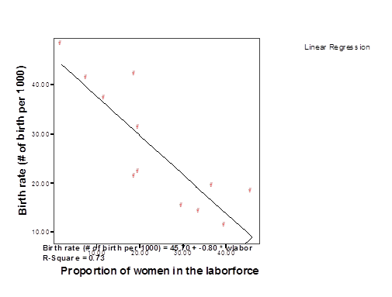
e.g. Linear relationship

Slide 4
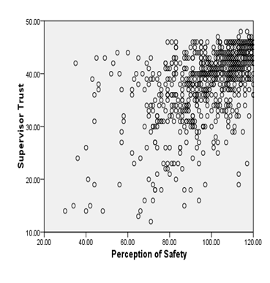
e.g. non-linear relationship

Slide 5
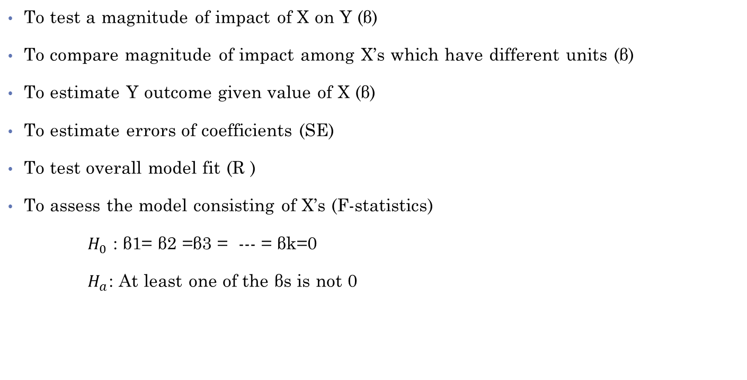
2. Interpretations of MRA and Diagnostic Techniques
To test a magnitude of impact of X on Y (β)
To compare magnitude of impact among X’s which have different units (β)
To estimate Y outcome given value of X (β)
To estimate errors of coefficients (SE)
To test overall model fit (R )
To assess the model consisting of X’s (F-statistics)
$H_{0}$ : β1= β2 =β3 = --- = βk=0
$H_{a}$: At least one of the βs is not 0

Slide 6
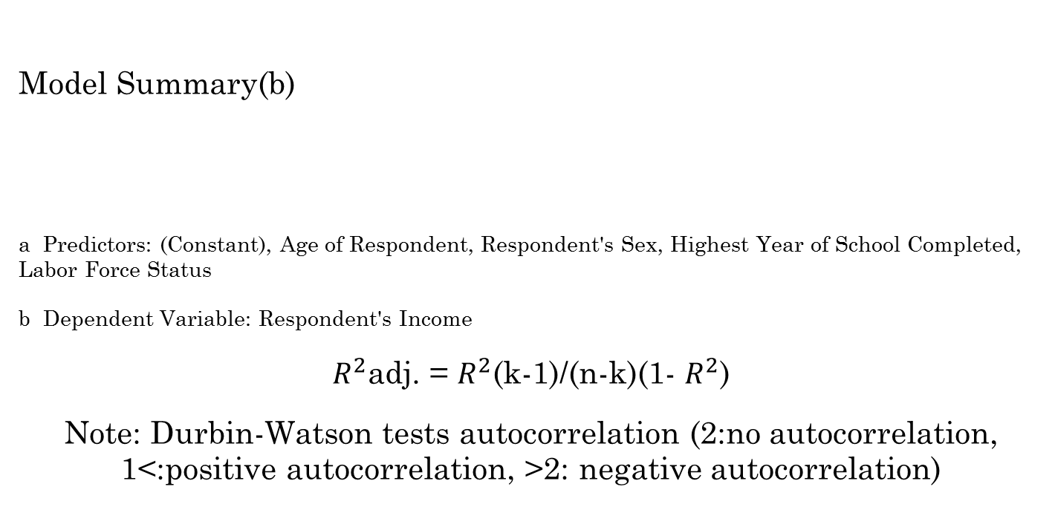
2. Interpretations of MRA and Diagnostic Techniques (cont.)
Model Summary(b)
a Predictors: (Constant), Age of Respondent, Respondent's Sex, Highest Year of School Completed, Labor Force Status
b Dependent Variable: Respondent's Income
$R^{2}$adj. = $R^{2}$(k-1)/(n-k)(1- $R^{2}$)
Note: Durbin-Watson tests autocorrelation (2:no autocorrelation, 1<:positive autocorrelation, >2: negative autocorrelation)
Model | R | R Square | Adjusted R Square | Std. Error of the Estimate | Durbin-Watson
1 | .620(a) | .384 | .381 | 4.228 | 1.747

Slide 7

2. Interpretations of MRA and Diagnostic Techniques (cont.)
ANOVA(b)
Model |  | Sum of Squares | df | Mean Square | F | Sig.
1 | Regression | 9519.009 | 4 | 2379.752 | 133.114 | .000(a)
 | Residual | 15267.433 | 854 | 17.878
 | Total | 24786.442 | 858
a Predictors: (Constant), Age of Respondent, Respondent's Sex, Highest Year of School Completed, Labor Force Status
b Dependent Variable: Respondent's Income
$F=R^{2}$ [n-(k+1)]/k(1- $R^{2}$)

Slide 8
2. Interpretations of MRA and Diagnostic Techniques (cont.)
Coefficients(a)
Y= 11.129 + 0.544 Education – 6.089 Labor Force Status
– 1.684 Sex + 0.105 Age
1=full time, 2= part-time; 1=Male, 2=Female
Model |  | Unstandardized Coefficients |  | Standardized Coefficients | t | Sig.
 |  | B | Std. Error | Beta
1 | (Constant) | 11.129 | 1.134 |  | 9.814 | .000
 | Highest Year of School Completed | .544 | .053 | .281 | 10.310 | .000
 | Labor Force Status | -6.089 | .400 | -.422 | -15.222 | .000
 | Respondent's Sex | -1.684 | .295 | -.157 | -5.706 | .000
 | Age of Respondent | .105 | .012 | .235 | 8.684 | .000
a Dependent Variable: Respondent's Income

Slide 9

2. Interpretations of MRA and Diagnostic Techniques (cont.)
Standardized Coefficient is used to examine relative effects of different IVs.
Beta represents the change in SD of Y when there is one SD increase in X, controlling for other IVs.
Beta=$β(σ_{x/ }σy)$

Slide 10
3. Assumptions in MRA (starred items can be statistically examined)
a) Ratio variables plus dichotomous variables
b) Normal distribution of DV*
c) Specification variables
Minimize measurement errors
d) Variables have linear relationship*
e) Homoscedasticity*
Errors are normally distributed around each X value
f) Errors are correlated neither with X’s nor with each other*
g) No multicollinearity*

Slide 11
Examples
FREQUENCIES
VARIABLES=wrkstat sex rincom91
/ORDER= ANALYSIS
Frequencies
[DataSet1] C:\Program Files\SPSS\GSS93 subset.sav

Slide 12
Examples (cont.)
Frequency Table

Slide 13
Examples (cont.)

Slide 14
Examples (cont.)
FREQUENCIES
VARIABLES=agewed educ rincom91 /FORMAT=NOTABLE /STATISTICS=STDDEV MINIMUM MAXIMUM SEMEAN MEAN MEDIAN MODE SKEWNESS
SESKEW
/HISTOGRAM NORMAL
/ORDER= ANALYSIS .
Frequencies
[DataSet1] C:\Program Files\SPSS\GSS93 subset.sav

Slide 15
Examples (cont.)
Check skewness see if DVs are normally distributed
Check histogram

Slide 16
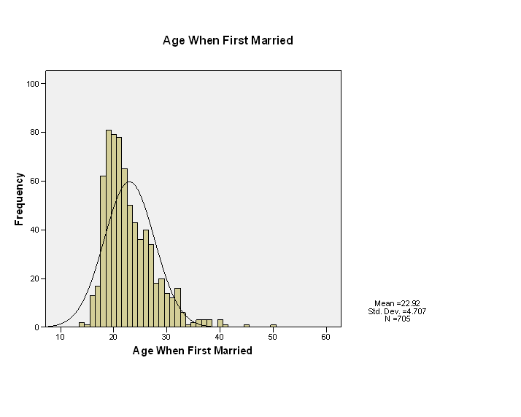
Histograms

Slide 17
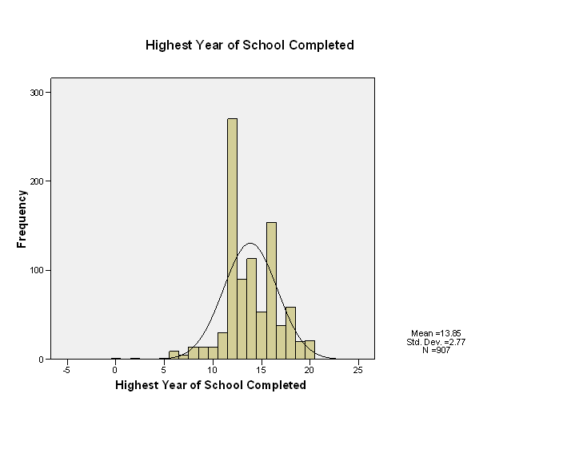
Histograms

Slide 18
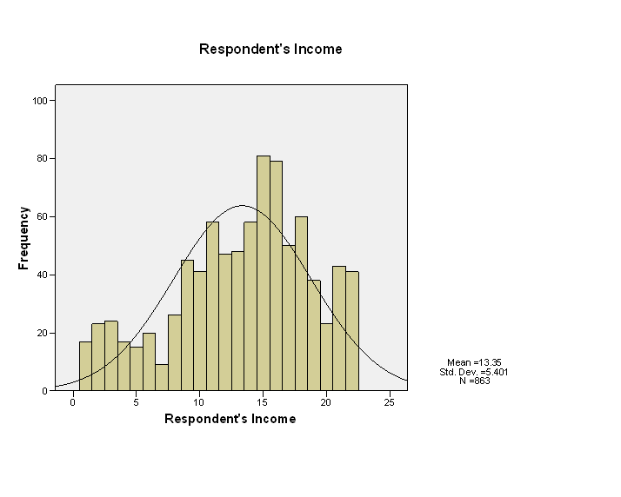
Histograms

Slide 19
SPSS Input
REGRESSION
/MISSING LISTWISE
/STATISTICS COEFF OUTS CI R ANOVA COLLIN TOL ZPP
/CRITERIA=PIN(.05) POUT(.10)
/NOORIGIN
/DEPENDENT rincom91
/METHOD=ENTER educ wrkstat sex age
/SCATTERPLOT=(*ZRESID ,rincom91 )
/RESIDUALS DURBIN HIST(ZRESID) NORM(ZRESID)
/CASEWISE PLOT(ZRESID) OUTLIERS(3)
Regression
[DataSet1] C:\Program Files\SPSS\GSS93 subset.sav

Slide 20
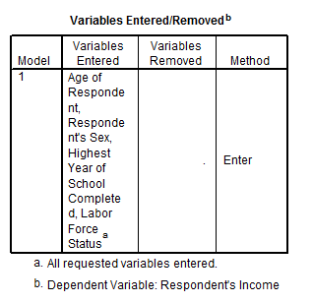
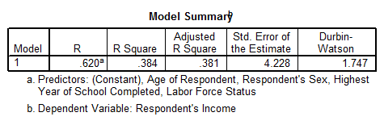
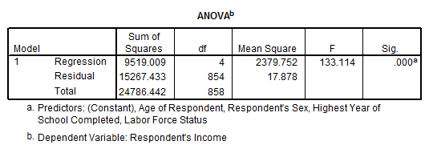
Coefficients table

Slide 21
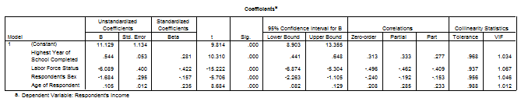
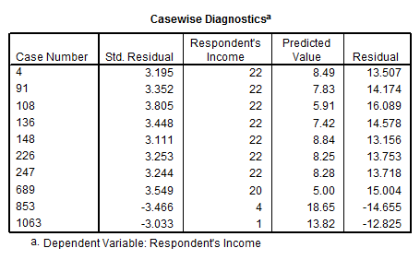
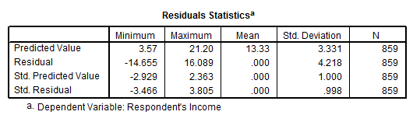
Table (cont.)

Slide 22
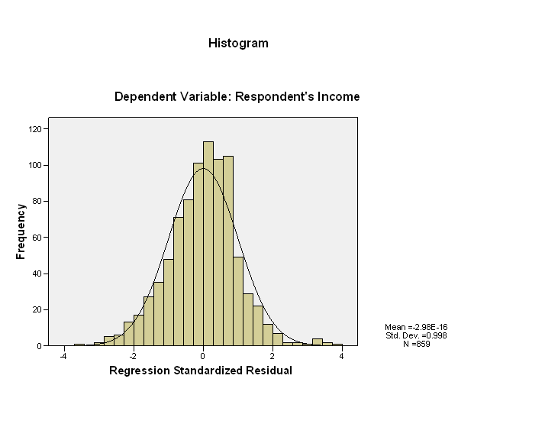
Graphs - Histogram

Slide 23
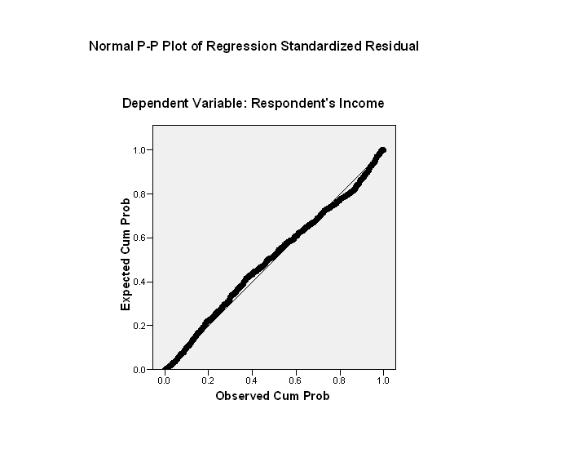
Graphs – P-P Plot

Slide 24
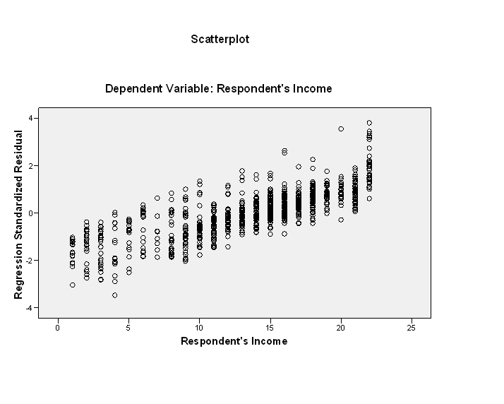
Graphs - Scatterplot

Slide 25
Questions?

